Slide 1
to Onyx Class
Monday 9th September 2019.

Slide 2
Mrs Newton
Mrs Coleman

Slide 3
Our School Aims
Securing the foundations for our children on their journey through life Opportunities to work together with parents and the wider community Utilising the rural outdoor learning environment Nurturing our children, inspiring them to be confident, respectful and resilient Developing life skills, values, teamwork and a love for learning.
Our Sound Superstars ….
Be Resilient
Be Curious
Be Independent
Be Caring
Be a Team Player

Slide 4
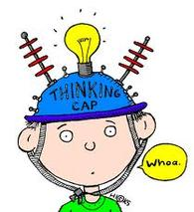
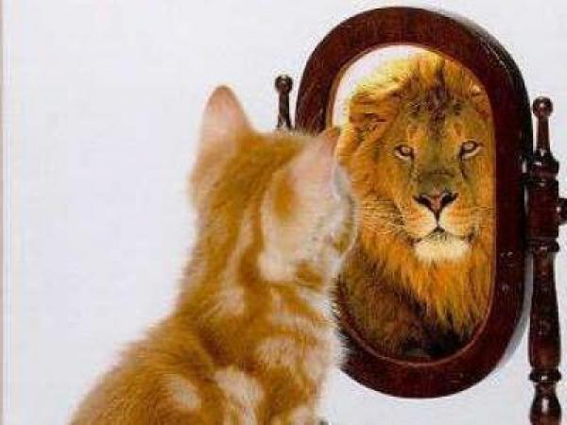
What we aim for…
Independence
Resilience
Respect
Good Communication
Enthusiastic Learners
Creative Thinking
Confidence
Responsible
Risk taking
Team players
Decision Making

Slide 5
Role Models
Opportunities to lead others/take on different roles
Buddies
Year 6 responsibilities-Head Boy/Girl/Captain/Vice/Sports
Class/whole school roles
Classroom set up/Working Walls/Talk partners
Expectations
Wider opportunities
Inter-school working
Sound School Council

Slide 6
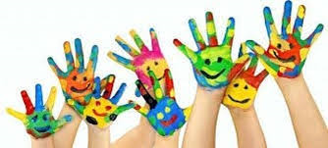
English-Primary Writing Project
Maths
Science
Computing
SPAG
Geography & History-skills based
Art/Design & Technology
PE (including Golden Mile)
French
Music
PSHE/British Values/Global Learning
RE

Slide 7
Accelerated Reader

Slide 8
Writing

Slide 12
Topics…
Autumn – Titanic (natural resources)
Spring – Ancient Greece (Europe)
Summer – Life In Britain since 1948 (settlements in UK)

Slide 13
Swimming-Mondays (Autumn term)
Session 2 - Tuesday PM
Golden Mile

Slide 14
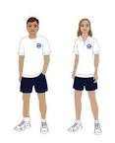
Black/blue shorts
White/blue T-shirt
Tracksuit (woolly hats are useful in the winter months!)
Trainers (both indoor & outdoor in winter)
Please put your child’s name in every item!

Slide 15
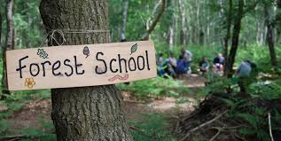

Slide 16
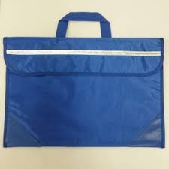
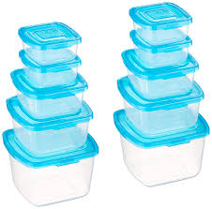
Bags
Lunchboxes
Drink bottles
Recycling

Slide 18
Friday
Spellings
New spellings set & sent home
Test – following Friday
Half-termly spellings test
Weekly spelling rule focus
Homework
Maths & English Homework sent home
Return all homework by Wednesday am
It is vital for your child to read at least 5 times per week. Please record in their diary and parent/adult to initial.

Slide 20
SATs…
Week commencing Monday 11th May, 2020
Boosters from February Half Term

Slide 21
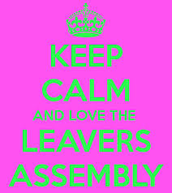
Thursday 16th July 2020

Slide 22
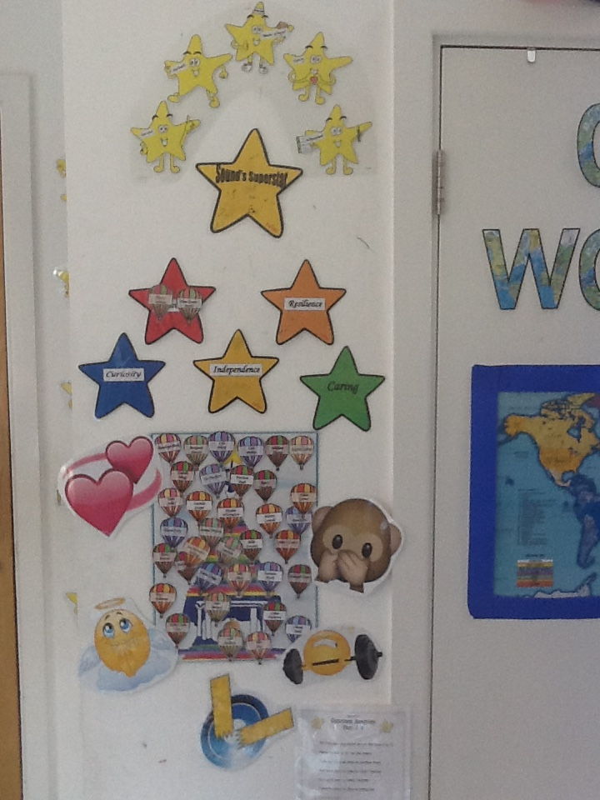
Behaviour…
Sound Super Star Awards
Sound Bell Tower
? Warning: make a choice…
! Time out in partner class
Deputy Head or Headteacher-
phone call home/parent meeting

Slide 23
Help from home…
Reading of different genres & questioning for understanding
Mental Arithmetic – multiplication table, square numbers, prime numbers, square roots etc (Y5 Multiplication Tables)
Spellings
Handwriting
Extra work after lessons – DRIP! DRIP!
Useful websites: BBC Skillwise, Coxhoe Durham, TOPMARKS, Nrich
Checking homework-not doing it!

Slide 25
Questions…

