Slide 1

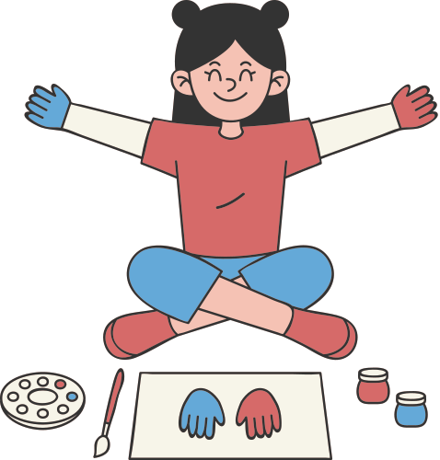
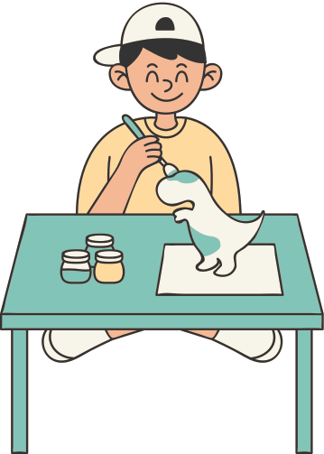
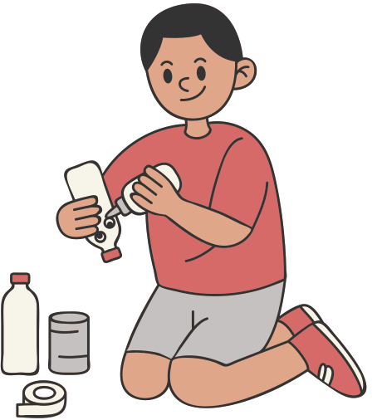
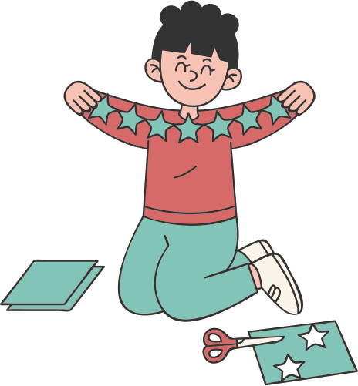
Welcome
Back to School
Opal Class!

Slide 2
Welcome to Opal Class!
I am delighted to welcome all our students to an exciting new school year. Our classroom is a welcoming and colourful space where we will learn and grow together.

Slide 3
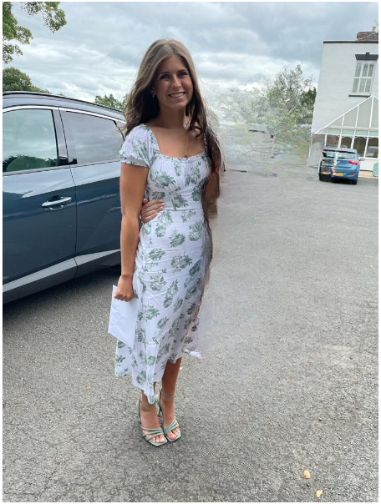
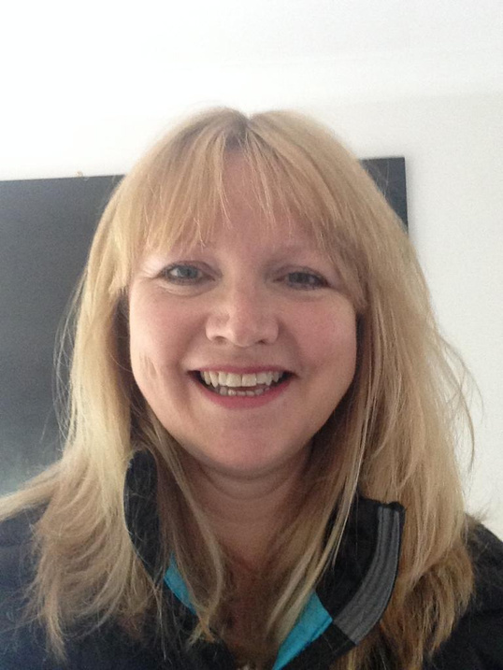
MEET YOUR TEACHERS
My name is Miss Hembury-Hayward. I will be your Teacher this year. This is my second year teaching. I am passionate about creating a positive and engaging learning environment for my students.
My name is Mrs Thompson. I will be your Teaching Assistant this year. I started working at Sound and District Primary school in October and I have loved my first year here! I used to be an Art Teacher in Secondary School so I will be helping you with lots of art projects.

Slide 4
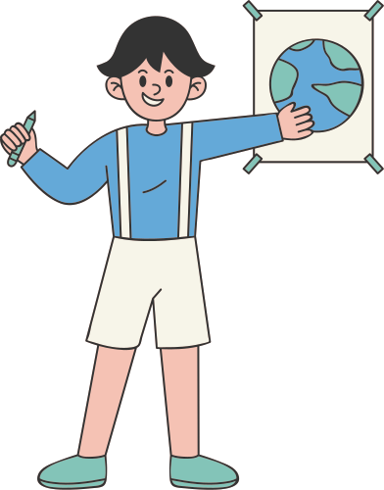
Yearly Overview
We will cover various topics throughout the year to expand your knowledge and spark your child's curiosity. Here is just a few!
Anglo-Saxons
Maps
Vikings
Maya Civilisation
Eastern Europe
Swimming
Computing
Food Technology
French
3D Sculpture

Slide 5
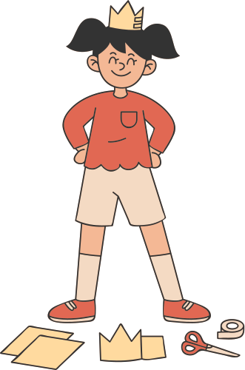
Daily routine
Our routine may need tweaking each term due to swimming and other amazing learning opportunities, but this is the main structure.
8:30
School Bell
Monday
Geography/History
PE
8:30-9
Early Morning work
Tuesday
French/Music
RE
9-10
Maths
10-10:30
SPAG/Reading
Wednesday
Computing
PE
10:30-10:50
Break
Thursday
Art/DT
PSHE
10:50-12
English
12-1
Lunch
Friday
Science

Slide 6

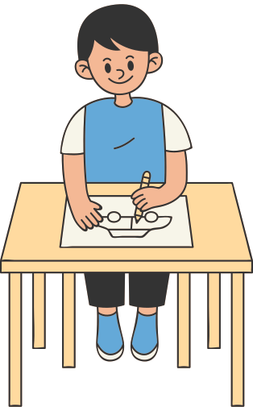
class rules
Listen attentively when others are speaking.
Be kind and respectful to your classmates.
Take care of our classroom and materials.
Always try your best and have a positive attitude!

Slide 7
Home-School Communication
It is really important that as a school we keep strong communications between home and school. You can use the methods below to share information with staff at Sound.
  Use the children’s diaries/planners
  Speak directly to a member of staff
  Contact the office on 01270780270 or admin@sound.cheshire.sch.uk to arrange a meeting.
  All communications should first and foremost go through to the class teacher, unless it is something which is needed to be directed to the deputy or headteacher.
  We will be keeping you regularly updated through the website, facebook and newsletter about what your child is doing in class.
  Reminders, or other general information will go through our teachers2parentsapp.
  https://soundprimary.co.uk

Slide 8

MICROSOFT TEAMS
All children have a Microsoft Teams account which will be used for:
  Sharing recordings of performances throughout the year
  Virtual Meeting Links (where appropriate)
  Termly links to homework task or sharing of a resource
  Assembly slides shared where appropriate
Anything shared on Microsoft Teams can only be seen by the class group. Further information on Microsoft Teams can be found on our webpage.

Slide 9
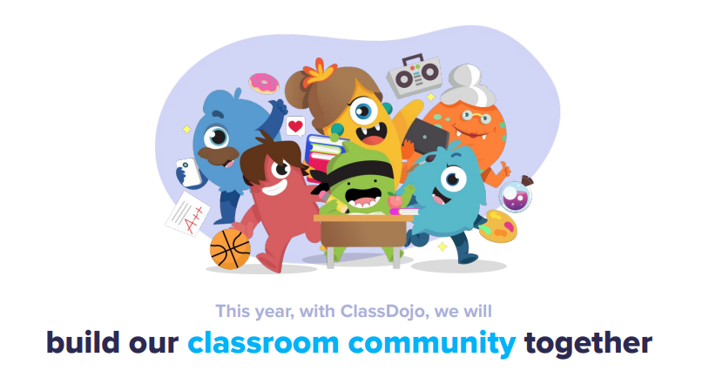
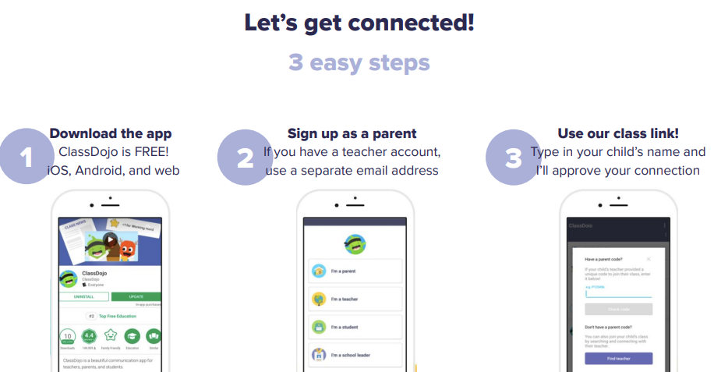
Class Dojo
We are excited to be trialling Class Dojo in EYFS, KS1 and KS2. This is a school/home communication app that can be used to share work, information, and achievements! You will be able to see what we get up to in school and any team points your child has earnt. I will go into more detail at the end of the meeting.

Slide 10


Times Tables Rockstars
Times Tables Rock Stars (TTRS) is an exciting times tables app that we will be using in school and at home. Children will be expected to use this app throughout the week. Each game takes 3-5 mins so it's perfect to fit into their routine e.g. in the car, before dinner, waiting for the bath to run etc.

Slide 11
Accelerated Reader
Children will take a star reading test to determine their reading level. This gives us a ZPD for your child which decides the book band that they will be choosing their books from. Once they have completed the book your child will take a short quiz which will indicate if they have understood what they have read.

Slide 12




HOMEWORK
Spelling tests will be each Friday. New spellings will be given in school and posted onto their Class Dojo portfolio for them to practice.
Children should read every night and complete AR quizzes in school regularly.
TTRS should be done each night.
Any other homework will be posted to Class Dojo.
If you are ever unsure about any homework then please LET ME KNOW!
Homework on Dojo
Spellings
TTRS
Reading

Slide 13

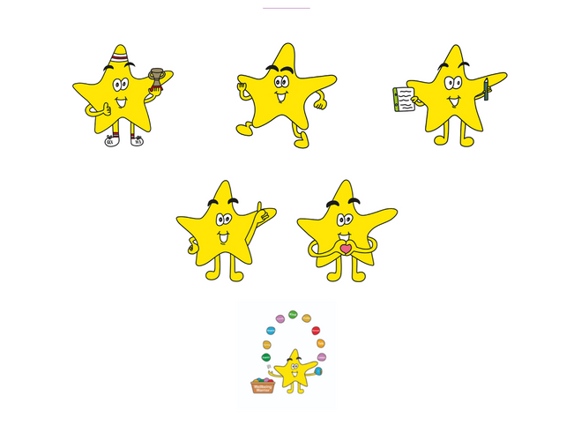


Behaviour policy
We have high expectations of all the children in our class. We expect them to follow the school rules along with the class charter they created themselves. It’s important we celebrate and support the children to make the right choices with rewards. Full details of our Behaviour Policy can be found on our website.
Class Dojo
Superstars
Hot chocolate with a teacher
Head Teacher Award

Slide 14
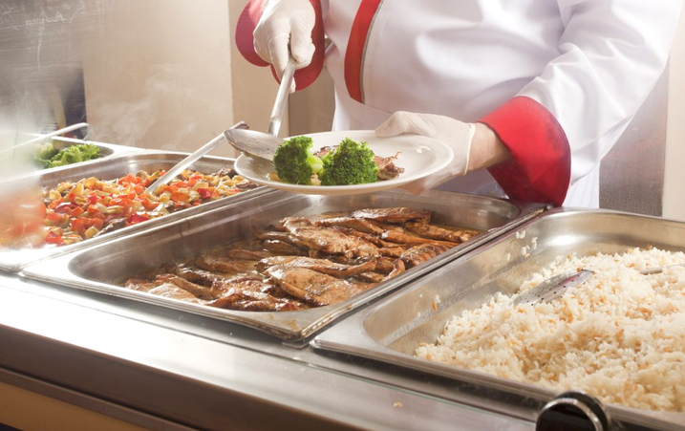

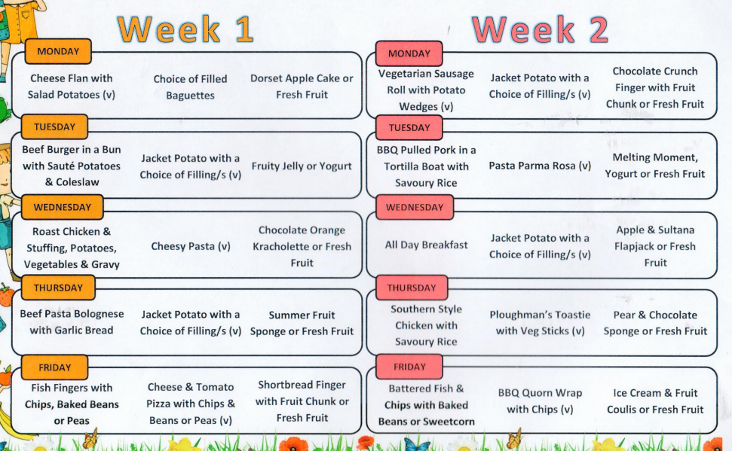
School Dinner
As your child is now in Year 3 they are no longer entitled to free school meals and fruit at break time. To order school dinners in Year 3 you go to the following :
https://eduspot.co.uk/product/teachers2parents/
Sign in with your unique username and password
Go to the school dinners icon and you can book your daily meals (£2.30 a day.)

Slide 15

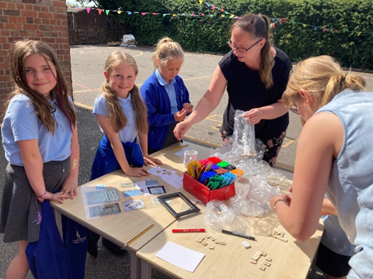
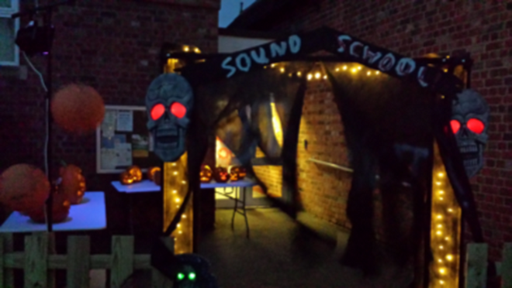

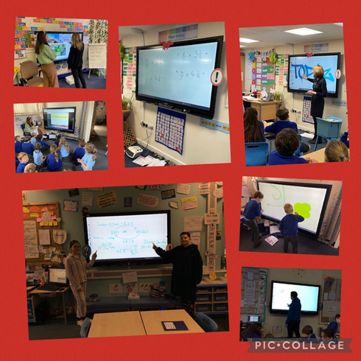

PTA
At Sound and District we have a very supportive PTFA who help to raise funds for the school, organise exciting events and experiences for the children ad help to further develop a strong parent – school relationship.
If you would like to join ‘The Friends of Sound’ and work closely with the school, please contact the school office for further information.
Come and join us this Saturday 11:00am-2:00pm for our rearranged Summer Fayre!

Slide 16
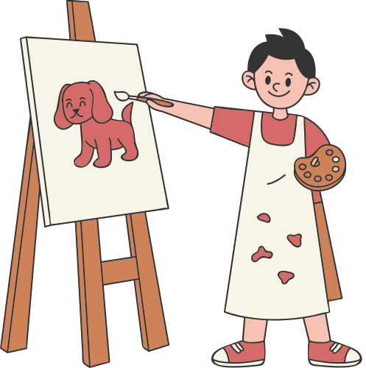
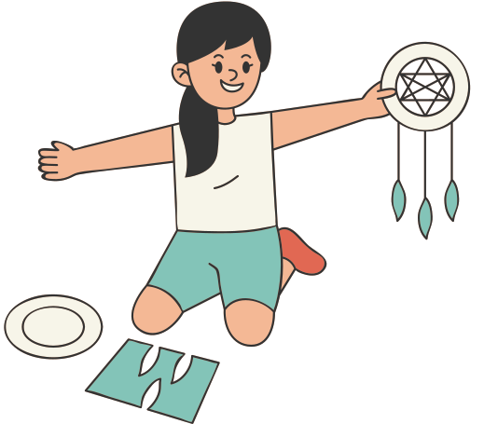
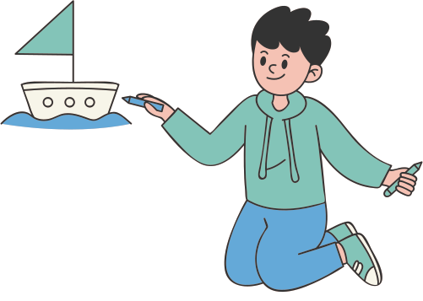
let's have a great year!
Congratulations! You have been introduced to Opal Class and all the exciting things we have in store. I am thrilled to embark on this journey with all of you. I am confident that we will have a fantastic year of learning and growth.

Slide 17
THANK YOU!
Any questions?

