Slide 1
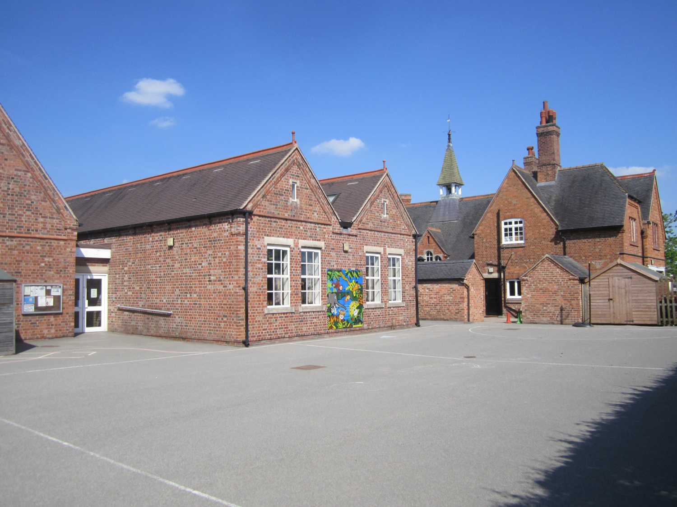
Sound and District Primary School
Meet the teacher
Reception meeting for parents and carers
September 2025

Slide 2
Meet The Teachers
Class Teacher
Mrs Billingham
Higher Level Teaching Assistant
Mrs Huntbach

Slide 3





Our Sound Superstars ….
Be Resilient
Be Curious
Be Independent
Be Caring
Be a Team Player

Slide 4
Key notes about school
School starts 8.30am (children need to be lined up on the yellow line ready). If your child is at Breakfast club, they will be supervised so they can join the line at 8.30am.
You are welcome to use the school drop off from 8.20am at the car park.
School finishes at 3.00pm.
Mrs Ashley runs our before school and after school wraparound care at Outdoor Fun.

Slide 5
Collecting children
Please let us know if someone different from usual is collecting your child. You can either ring the school office or speak to the member of staff in the morning to pass on the message.
Please also let us know if someone on a regular basis will be collecting your child (e.g. Grandparents on a Tuesday).
If someone comes to collect your child and we do not know who they are, we will not be able to send your child with them until this has been checked with you.

Slide 6
Sound and District Primary School
Learning more about expectations in Reception

Slide 7
What is the Early Years Foundation Stage?

Slide 8
The Early Years Foundation Stage (EYFS) Areas of learning
The Foundation Stage Curriculum (revised 2012)
There are 3 Prime Areas
1. Personal, Social and Emotional Development
2. Communication and Language
3. Physical Development
Then there are 4 Specific Areas
4. Literacy;
5. Mathematics;
6. Understanding the World;
7. Expressive Arts and Design

Slide 9
National Expectations
By the end of the Reception year the goal is for your child to be able to:
• Read simple sentences without help
• Write in sentences without help
• Order, recognise and write numbers 0-20
• Add and subtract with simple numbers equally
• Double and halve and share amounts
Regular attendance is crucial in order to help support children achieve this.

Slide 10
Baseline assessment
Throughout the year in Reception, we assess the children against the ELGs and earlier developmental age bands. This is usually through observation of the children during their chosen activities. We measure their progress and set specific targets to help children to develop skills.
To begin the year we make an initial assessment indicating children’s starting points.

Slide 11
The EYFS Profile
At the end of the school year you will receive an EYFS profile for your child, detailing whether they have met the goals for each area of learning.
You will be told whether your child’s development is emerging, expected or exceeding in relation to the goals.
Your feedback and contributions from home on where your child is achieving on the Profile is really important to us to help us to inform our assessments (Class Dojo).

Slide 12
Sound and District Primary School
In the classroom

Slide 13
Classroom routines
Each day there will be a mixture of:
Exploration and Play
Whole Class Learning (number rhymes and songs, counting, games, listening to stories, learning and talking about number facts, watching shared writing)
Guided Group Work (working with other children and a teacher)
Independent Group Work (working with other children alone)

Slide 14
Mathematics – Number
By the end of the year the children have to be confident with numbers to 20.
This does not mean just being able to count to 20, but understanding number thoroughly, e.g. that the number 8 is the same as double 4, or 5 +3, or 2+6, or 1+7 etc.
The children will learn how to add, subtract, divide (“share”), halve and double over the year.

Slide 15
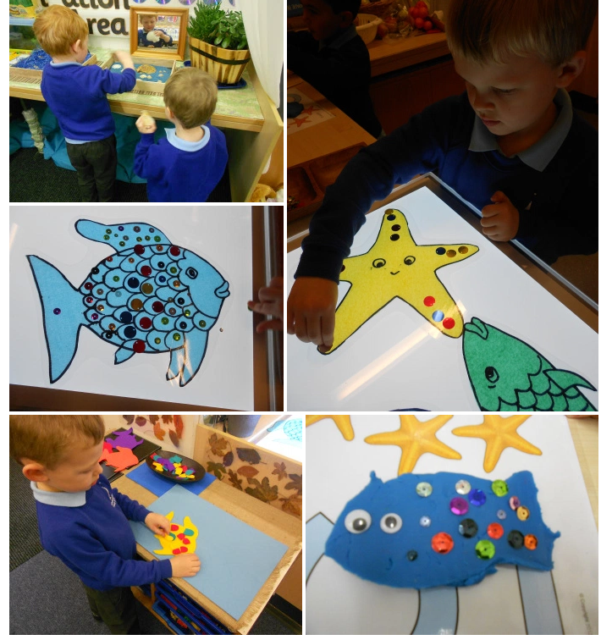
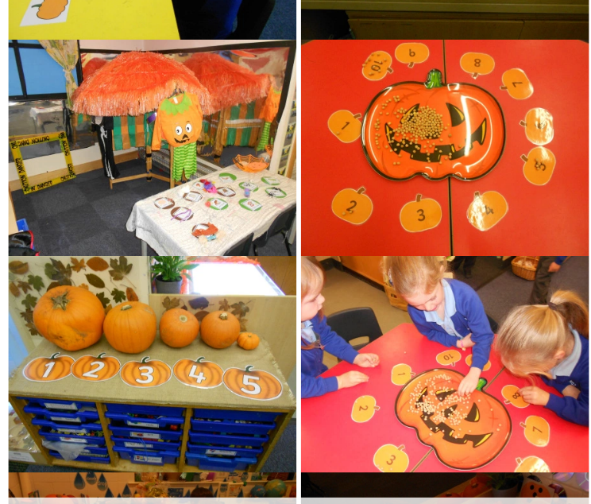
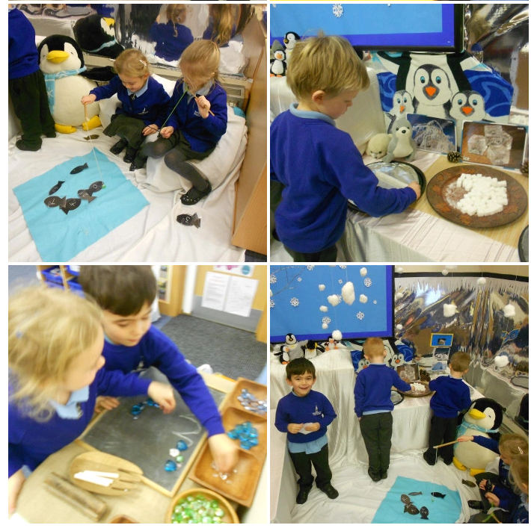
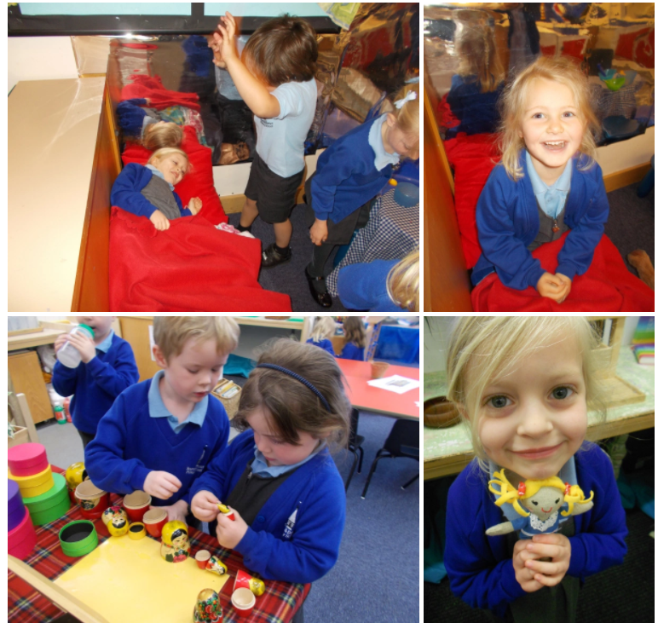
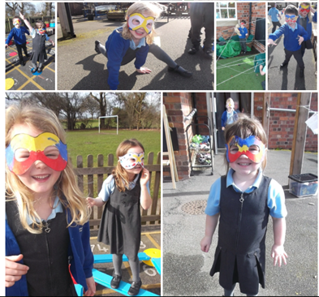
Halloween
Under the sea
Winter Wonderland
Topics are selected and enhanced by the children’s interests in their play.
We set up different activities and can amend the classroom layout to encourage different types of play and learning.
Activities to develop particular aspects of learning can be set up.
Goldilocks
Superheroes

Slide 16





Positive Discipline
Lots of praise for good work and behaviour.
Team Points (colour teams) via Dojo
Certificates
Head Teacher Awards
Sanctions displayed clearly for when necessary.
Made and agreed by the class/school.

Slide 17
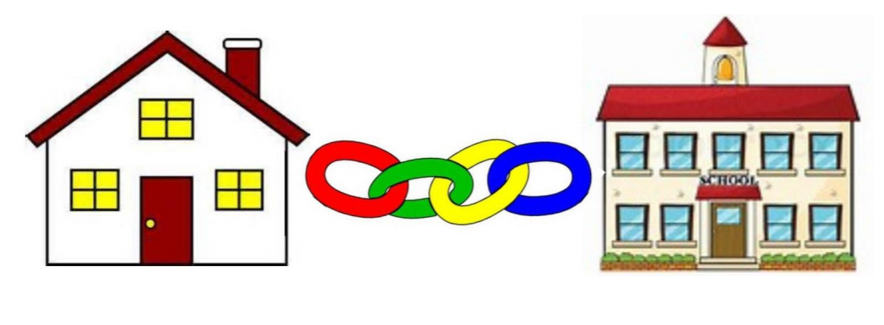
Home/School links
Reading
Daily reading is key!
Writing in the planner
We will provide a Reading Record for you to record reading at home and like to use these books as another method for ensuring a strong home-school link.

Slide 18
Book bags and PE kits
Please make sure children bring their book bags into school each day (except for trip days). You may personalise the book bag with one key ring so children can easily identify their bag.
Children will need to come into school dressed in their PE kits on Mondays as this will be our P.E. day.

Slide 19
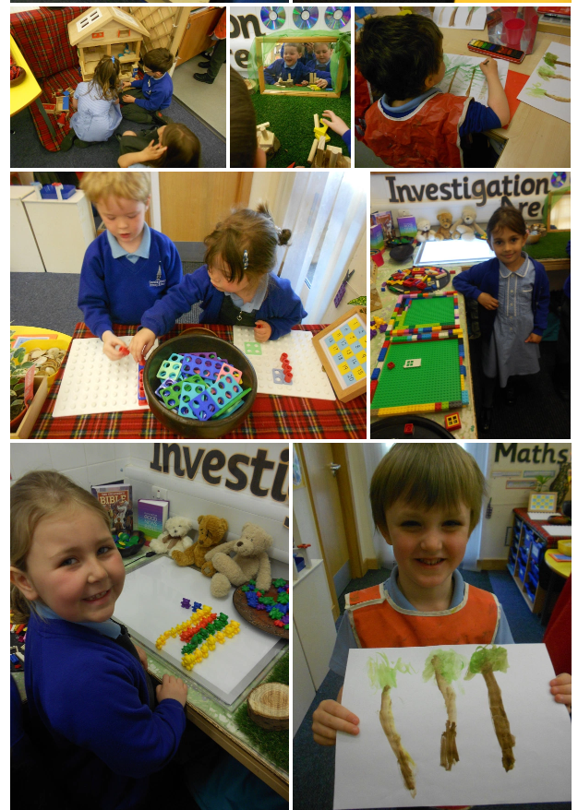
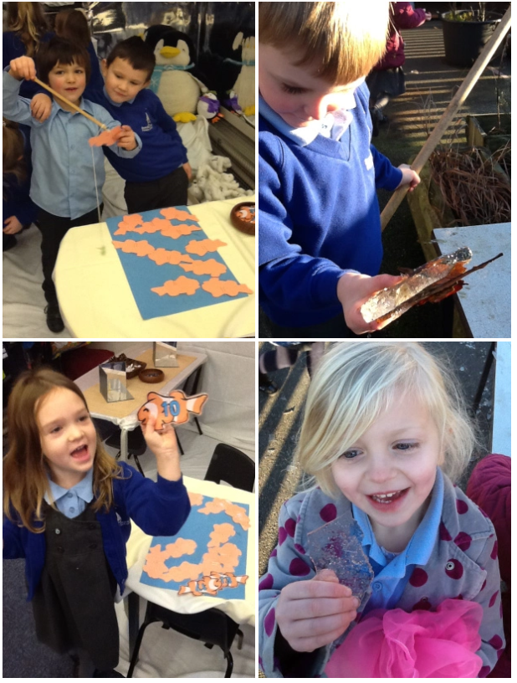
Class website and Dojo
Please check our Class Dojo regularly to see learning in Diamond Class. This is where I will also write regular updates.

Slide 20
Fruit and water
Children in Reception and Key Stage One (Years one and two) are provided with a piece of fruit each day.
Each child will also need to have an individual water bottle to access water throughout the day.
At Sound we promote healthy living, through exercise and diet.

Slide 21
P.E.
P.E Kit
Black shorts/leggings
Navy T Shirt
School hoodie or school jumper/cardigan(woolly hats are useful in the winter months!)
Trainers (Velcro helps with independence)
Please put your child’s name in every item!
Please remove children’s jewellery
before coming to school on these days.

Slide 22

Year 6 buddy
We will pair your child with a Year 6 buddy as another form of pastoral care. It is a wonderful system and the Year 6 children assist during play and lunch times as well as through some learning times (e.g. listening to the Reception children read).

Slide 23

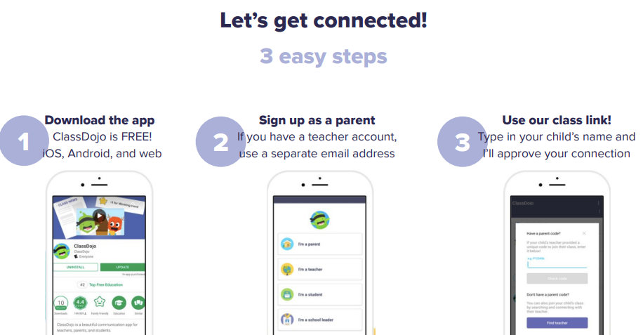
Class Dojo
We are excited to be using Class Dojo in EYFS, KS1 and KS2. This is a school/home communication app that can be used to share work, information, and achievements! You will be able to see what we get up to in school and any team points your child has earnt. I will go into more detail at the end of the meeting.

Slide 24
Our doors are always open.
Come and see us or use the planners to write and tell us about anything you are concerned about.
Tell us before it becomes a bigger issue.
Tell us the good things as well!
Together we can support your child on their exciting journey.

Slide 25
Home - School Communication
It is really important that as a school we keep strong communications between home and school. You can use the methods below to share information with staff at Sound.
Use the children’s diaries/planners to record reading through the week.
If you wish to speak directly to a member of staff (and it is something you would rather not share in the planner or SHOULD NOT BE SHARED ON CLASS DOJO) either ring the school office (01270780270) to arrange a meeting or email admin@sound.cheshire.sch.uk . They will then get back to you as soon as possible. Please add for the attention of (add teacher/staff member it is for)
All communications should first and foremost go through to the class teacher, unless it is something which is needed to be directed to the Deputy, Headteacher.
We will be keeping you regularly updated through the website, Facebook, Class Dojo and newsletter about what your child is doing in class.
Reminders, or other general information will go through our teachers2parentsapp and Class Dojo. We will be keeping both running as we trial its use for the whole school. Microsoft Teams will be used for Virtual Parent Meetings.
https://soundprimary.co.uk

Slide 26
Sound School Communications
Please see below the communications that will be used by Sound School and what for.
Teacher2Parents (Eduspot) | Class Dojo | School Website | School Facebook | Face to Face
Admin/Staff emails | Children's Dojos for Positive Behaviour | Whole School key documents | Weekly highlights of school events & achievements for our wider community | Staff/Headteacher on the playground at the beginning and end of day – quick memos.
Electronic letters | Share pupils work and achievements | School Policies/Procedures |  | In person Parent Meetings
Confidential Documents | Sharing pictures of the curriculum in action! | Galleries of achievements/ events over the whole year |  | Open Days
School Dinners | Class/whole school announcement/ reminders of events etc.. | Attendance Information
Parent Bookings |  | School Curriculum overviews
Confidential emails
All attendance queries

Slide 27

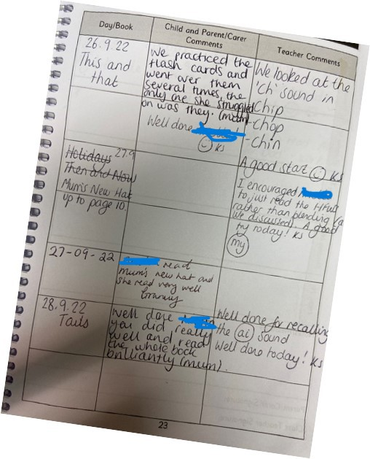
Reading Diaries
It is crucial that we continue with home and school using the diaries to show the reading they do at home and school. Please write in their diary when you hear your child read.

Slide 28
Class Dojo
We are excited to be trialing Class Dojo for the whole school. This is a school/home communication app that can be used to share work, information, and achievements! You will be able to see what we get up to in school and any team points your child has earnt. I will go into more detail at the end of the meeting.
We DO use this for:
Sharing your children’s learning and achievements with class dojos!
Whole class/school announcements of events or reminders
We DO NO use it for :
Concerns/complaints through private messaging – these STILL go through the schools central email.
Urgent, quick response messages – these still go through the school office
Any attendance queries or absences – these still go through the school office
PLEASE REFER TO THE CLASS DOJO CODE OF CONDUCT SO THIS GREAT APP CAN CONTINUE TO BE A GREAT SUCCESS!

Slide 29

Online Safety (Safeguarding)
Safeguarding Lead (DSL) : Mrs Minshall-Thomas Deputy Safeguarding Lead : Mrs Wagg,
Online Safety : Mrs Minshall-Thomas
Online Safety at Sound
- Built into the Curriculum Plans & special awareness days and weeks
- Continual Staff CPD
- School Safeguarding Team – pupil safeguarding leads work with the DSL, Safeguarding Governor, PC Jarvis & other external organisations
- Parental workshops and guides shared on our school platforms.
Online Safety - Sound and District Primary School (soundprimary.co.uk)

Slide 30

As well as the school office we now have the following contact : info@friendsofsoundschool.com

Slide 31
Our doors are always open.
Thank you for coming – do you have any questions?

