Slide 1



to Onyx Class
Monday 8th September 2025

Slide 2

Mrs Wagg
Mrs Coleman
and…..
Mrs Minshall-Thomas (Computing)
Mrs Kyle (RE, French)

Slide 3





Our School Aims
Our Sound Superstars (our values)….
Be Resilient
Be Curious
Be Independent
Be Caring
Be a Team Player
Be Mental Health aware

Slide 4

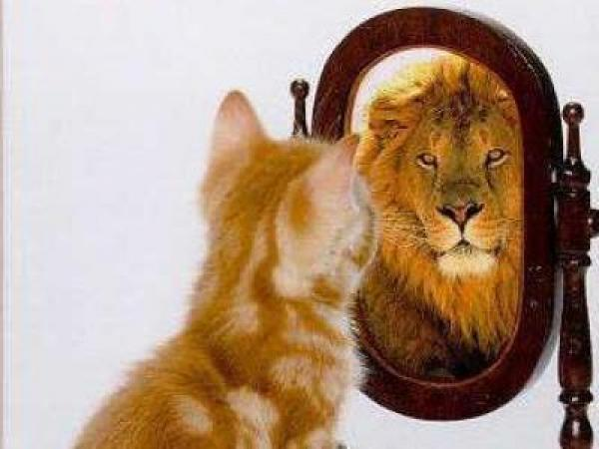


What we aim for…
Independence
Resilience
Respect
Good Communication
Enthusiastic Learners
Creative Thinking
Confidence
Responsibility
Risk taking
Team players
Decision Making

Slide 5

Role Models
Opportunities to lead others/take on different roles
Buddies
Year 6 responsibilities-Head Boy/Girl/Captain/Vice/Sports
Class/whole school roles
Classroom set up/Working Walls/Talk partners
Expectations
Wider opportunities
Inter-school working
Sound School Council

Slide 6



English-Primary Writing Project
Maths
Science
Computing
SPAG
Geography & History-skills based
Art/Design & Technology
PE
French
Music
PSHE/British Values/Global Learning
RE

Slide 7
Autumn 1 – Ancient Greece
Autumn 2 –Trade and economics
Spring 1 – Shang Dynasty
Spring 2 – Amazing Americas
Summer 1 – Our Changing World
Summer 2 – Leisure and Entertainment

Slide 8

Accelerated Reader

Slide 9

Writing

Slide 10
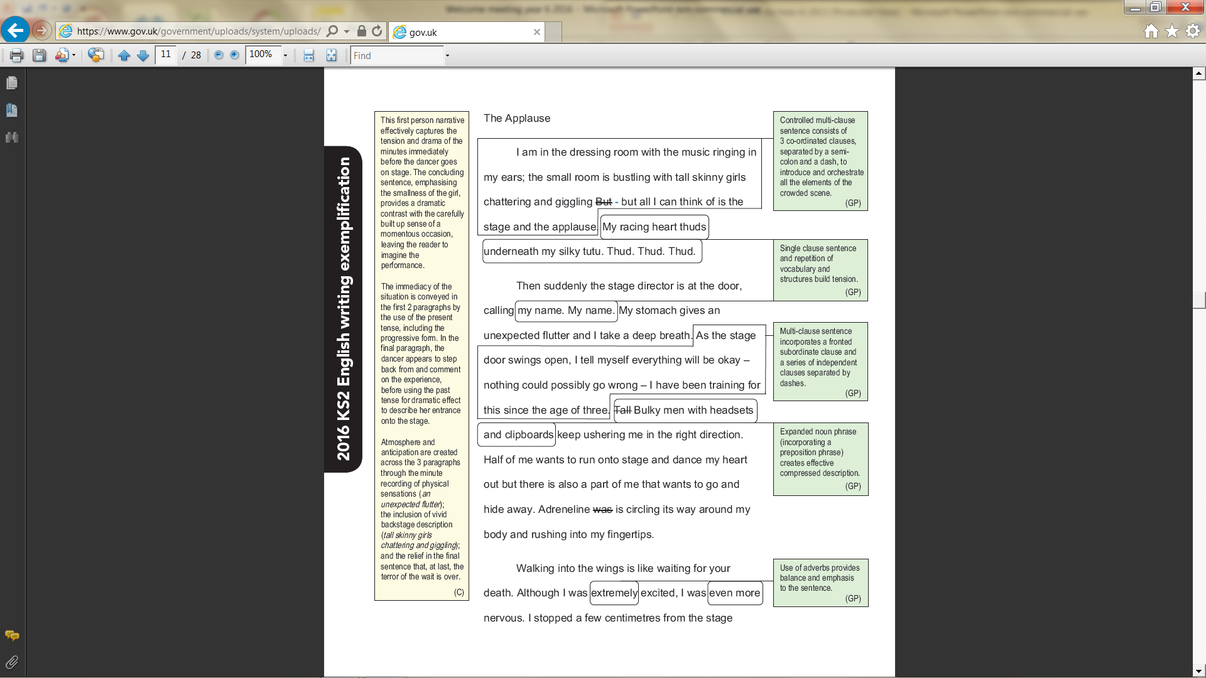

Slide 11


Slide 12


Children are to continue to come
into school wearing their PE kits.
P.E. Kit:
Black shorts
Navy T-Shirt
Sound Sports Hoodie
Dark Tracksuit (woolly hats are useful in the winter months!)
Trainers
Onyx PE sessions are on a Wednesday and a Friday.
Please remove all jewellery before coming to school on these days.

Slide 13
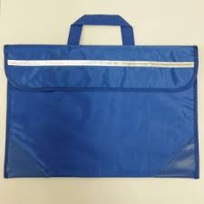


Bags
Pencil Cases
Lunchboxes
Drink bottles

Slide 14



Slide 15


Friday
Spellings
New spellings set & sent home
Quiz for application– following Friday (sentences)
Half-termly statutory spelling list words
Weekly spelling rule focus
Homework
Maths & English Homework sent home
Return all homework by Wednesday am
It is vital for your child to read at least 5 times per
week. Please record in their diary and parent/adult
to initial.

Slide 16

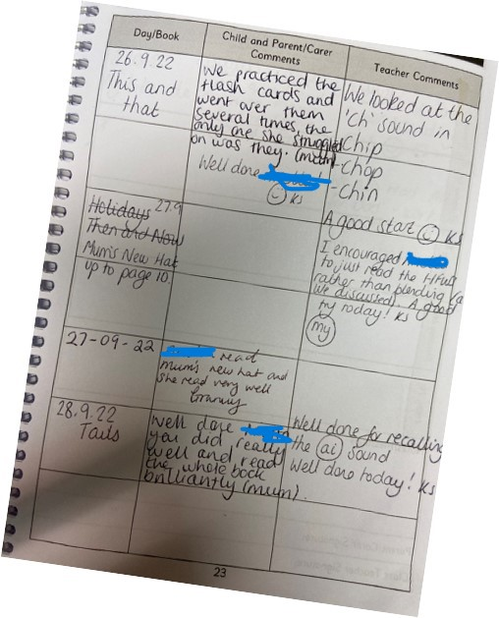
Reading Diaries
It is crucial that we continue with home and school using the diaries to show the reading they do at home and school. Please write in their diary when you hear your child read.

Slide 17
Home - School Communication
It is really important that as a school we keep strong communications between home and school. You can use the methods below to share information with staff at Sound.
Use the children’s diaries/planners to record reading through the week.
If you wish to speak directly to a member of staff (and it is something you would rather not share in the planner or SHOULD NOT BE SHARED ON CLASS DOJO) either ring the school office (01270780270) to arrange a meeting or email admin@sound.cheshire.sch.uk . They will then get back to you as soon as possible. Please add for the attention of (add teacher/staff member it is for)
All communications should first and foremost go through to the class teacher, unless it is something which is needed to be directed to the Deputy or Headteacher.
We will keep you regularly updated through our website, Facebook, and Class Dojo. You will also receive Mrs Minshall-Thomas’s weekly highlights, giving you a snapshot of what’s going on in school..
Reminders, or other general information will go through our teachers2parentsapp and Class Dojo. We will be keeping both running for now through school. Microsoft Teams will be used for Virtual Parent Meetings.
https://soundprimary.co.uk

Slide 18
Sound School Communications
Please see below the communications that will be used by Sound School and what for.
Teacher2Parents (Eduspot) | Class Dojo | School Website | School Facebook | Face to Face
Admin/Staff emails | Children's Dojos for Positive Behaviour | Whole School key documents | Weekly highlights of school events & achievements for our wider community | Staff/Headteacher on the playground at the beginning and end of day – quick memos.
Electronic letters | Share pupils work and achievements | School Policies/Procedures |  | In person Parent Meetings
Confidential Documents | Sharing pictures of the curriculum in action! | Galleries of achievements/ events over the whole year |  | Open Days
School Dinners | Class/whole school announcement/ reminders of events etc.. | Attendance Information
Parent Bookings |  | School Curriculum overviews
Confidential emails
All attendance queries

Slide 19
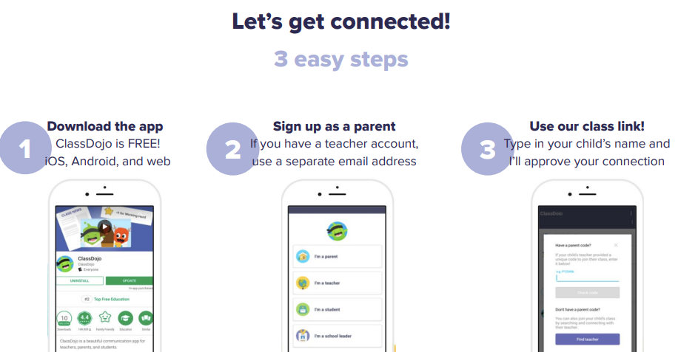

Class Dojo
We DO use this for:
Sharing your children’s learning and achievements with class dojos!
Whole class/school announcements of events or reminders
We DO NO use it for :
Concerns/complaints through private messaging – these STILL go through the schools central email.
Urgent, quick response messages – these still go through the school office
Any attendance queries or absences – these still go through the school office
PLEASE REFER TO THE CLASS DOJO CODE OF CONDUCT SO THIS GREAT APP CAN CONTINUE TO BE A GREAT SUCCESS!

Slide 20

Online Safety (Safeguarding)
Safeguarding Lead (DSL) : Mrs Minshall-Thomas Deputy Safeguarding Lead : Mrs Wagg,
Online Safety : Laura Minshall-Thomas
Online Safety at Sound
- Built into the Curriculum Plans & special awareness days and weeks
- Continual Staff CPD
- School Safeguarding Team – pupil safeguarding leads work with the DSL, Safeguarding Governor, PC Jarvis & other external organisations
- Parental workshops and guides shared on our school platforms.
- regular updates/useful guides shared on Class Dojo
Online Safety - Sound and District Primary School (soundprimary.co.uk)

Slide 21
SATs…
Week commencing Monday 11th May, 2026
(Please don’t book any holidays for this week!)
Parent Meeting-January
Boosters from February Half Term

Slide 22

Friday 17th July 2026

Slide 23





Positive Discipline
Lots of praise for good work and behaviour
Team/ Dojo Points
Wow Work
Fridge!
Accelerated Reader – prizes and incentives
Sanctions displayed clearly for when necessary. Made and agreed by the class/school.

Slide 24
Help from home…
Reading of different genres & questioning for understanding
Mental Arithmetic – multiplication table, square numbers, prime numbers, square roots etc (Y5 Multiplication Tables)
Spellings
Handwriting
Extra work after lessons – DRIP! DRIP!
Useful websites: BBC Skillwise, Coxhoe Durham, TOPMARKS, Nrich
Checking homework-not doing it!
COHESION!

Slide 25
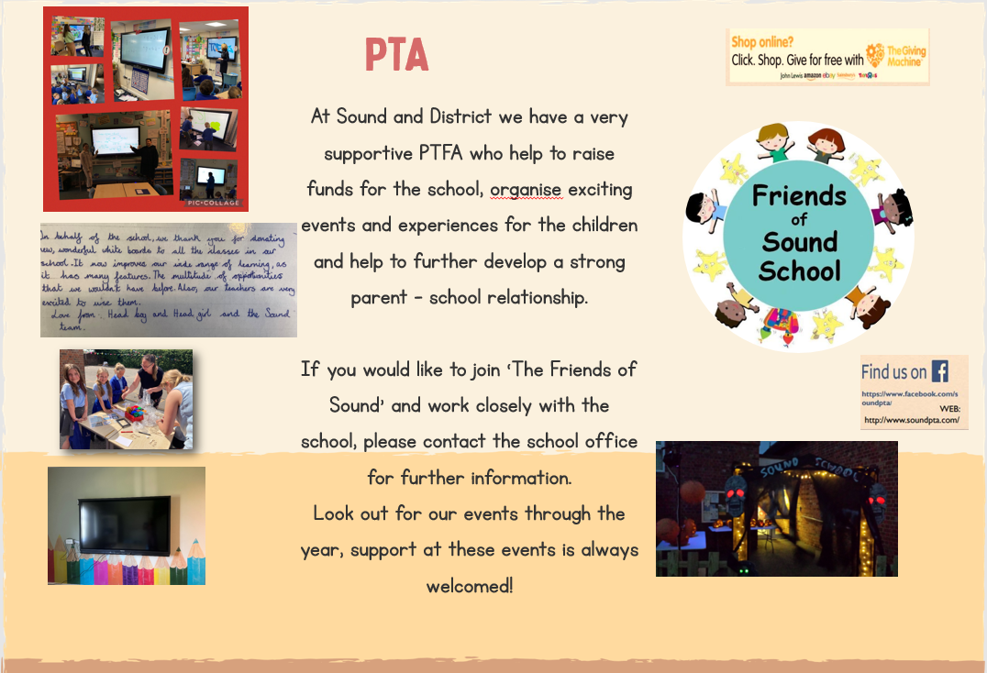
As well as the school office we now have the following contact : info@friendsofsoundschool.com

Slide 26

Questions…

