Slide 1




Sound and District Primary School
MEET THE TEACHER
OPAL Class
2025-26

Slide 2
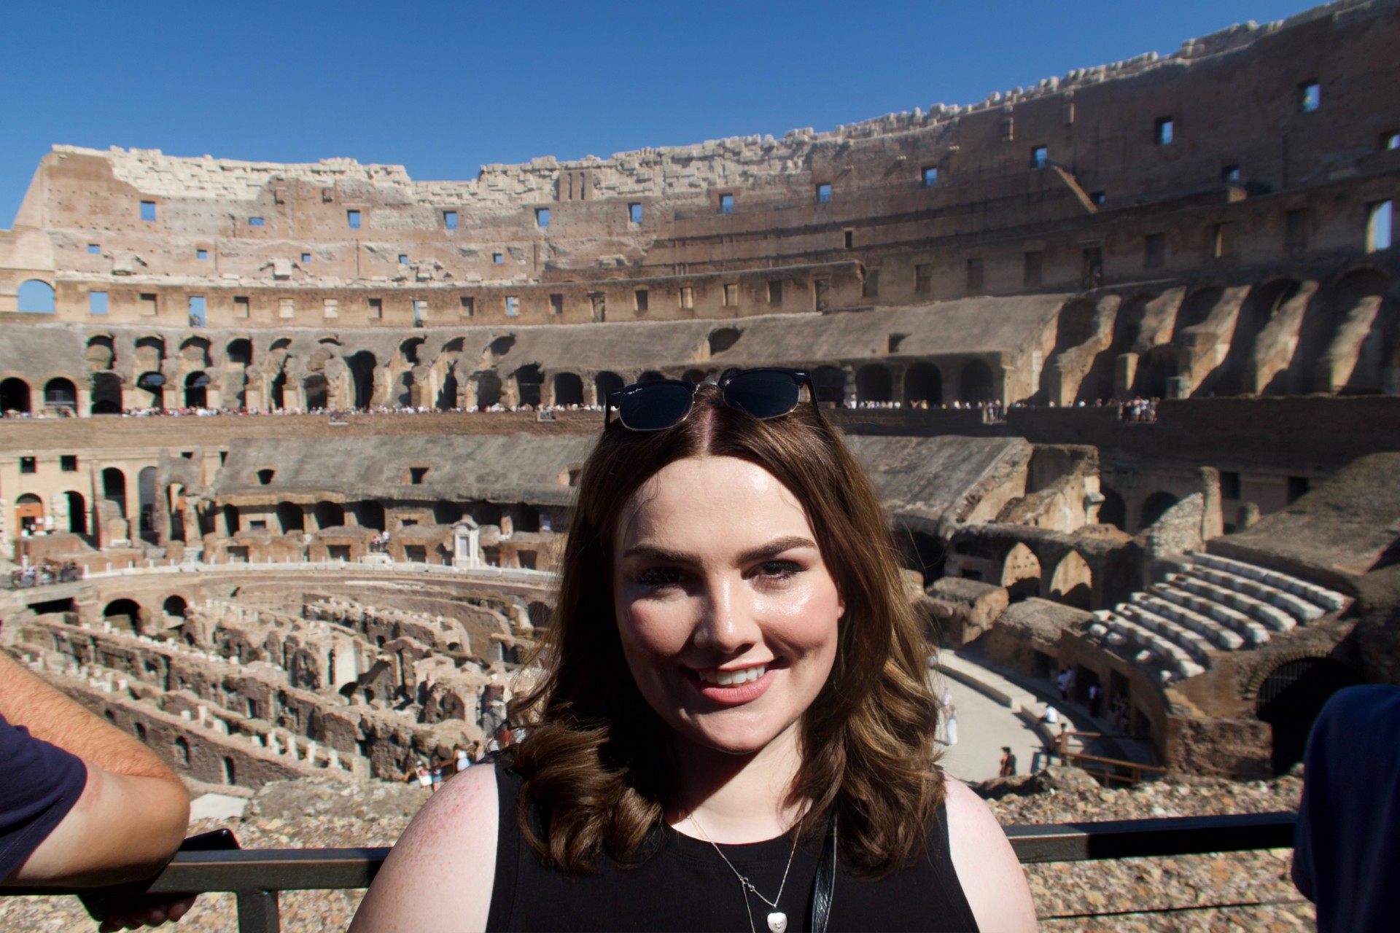
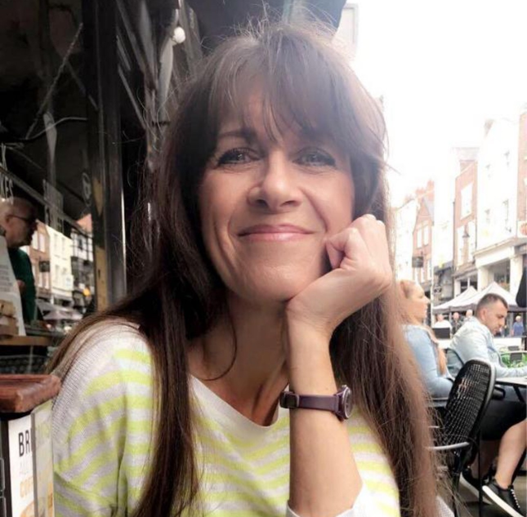
Opal Class Teachers
Miss Smith
MS MCADIE
CLASS TEACHER
TEACHING ASSISTANT

Slide 3
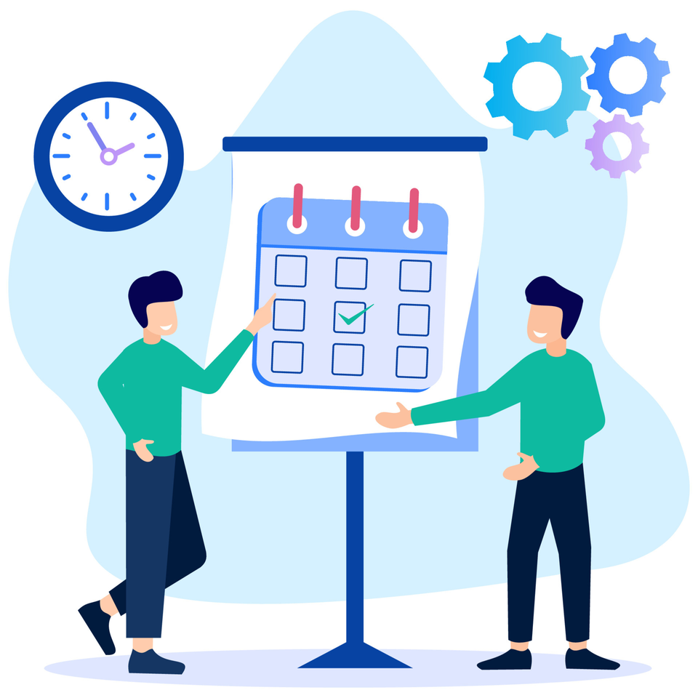
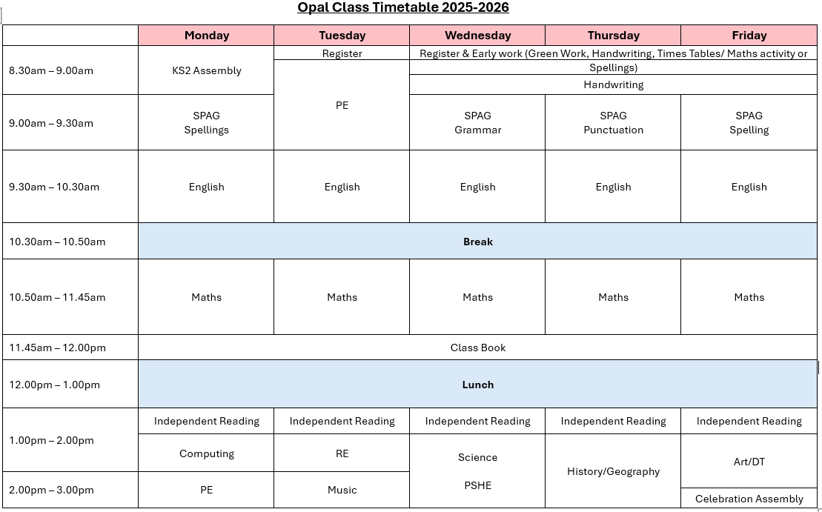
Timetable

Slide 4
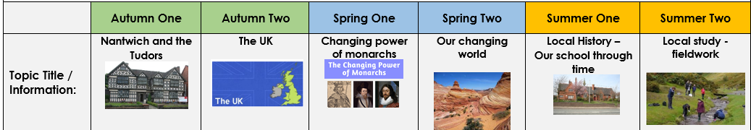

History/Geography Topics

Slide 5

PE
Children are to continue coming to school wearing their PE kits.
P.E. Kit:
  ◆ Black shorts
  ◆ White or light blue t-shirt
  ◆ Sound Sports Hoodie
  ◆ Dark Tracksuit
  ◆ Trainers
Opal PE sessions are on Monday and a Tuesday.
Please remove all jewellery before coming to school on
these days.

Slide 6
Home-School Communication
It is really important that as a school we keep strong communications between home and school. You can use the methods below to share information with staff at Sound.
Use the children’s diaries/planners to record reading through the week.
If you wish to speak directly to a member of staff (and it is something you would rather not share in the planner or SHOULD NOT BE SHARED ON CLASS DOJO) either ring the school office (01270780270) to arrange a meeting or email admin@sound.cheshire.sch.uk . They will then get back to you as soon as possible. Please add for the attention of (add teacher/staff member it is for)
All communications should first and foremost go through to the class teacher, unless it is something which is needed to be directed to the Deputy or Headteacher.
We will keep you regularly updated through our website, Facebook, and Class Dojo. You will also receive Mrs Minshall-Thomas’s weekly highlights, giving you a snapshot of what’s going on in school..
Reminders, or other general information will go through our teachers2parentsapp and Class Dojo. We will be keeping both running for now through school. Microsoft Teams will be used for Virtual Parent Meetings.

Slide 7
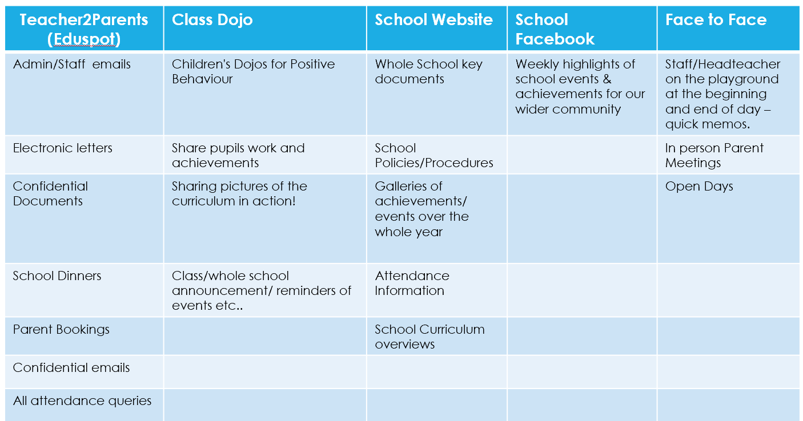
Sound School Communication

Slide 8
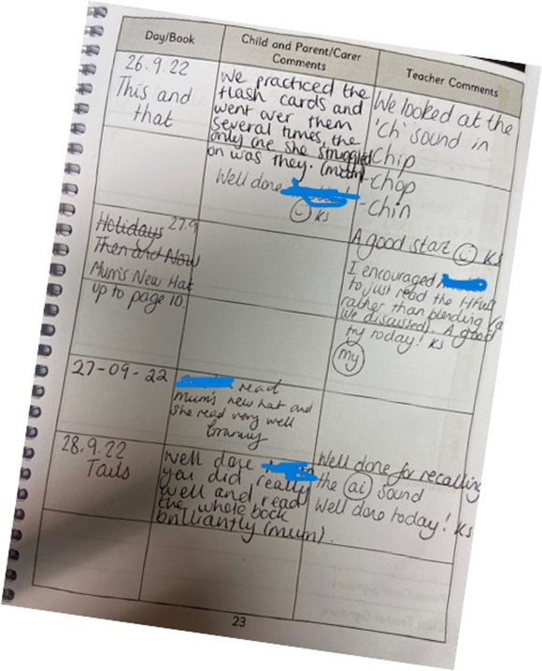

Reading Diaries
It is essential that we maintain the use of diaries at home and school to track the reading your child does. Please make a note in their diary whenever you listen to them read.

Slide 9
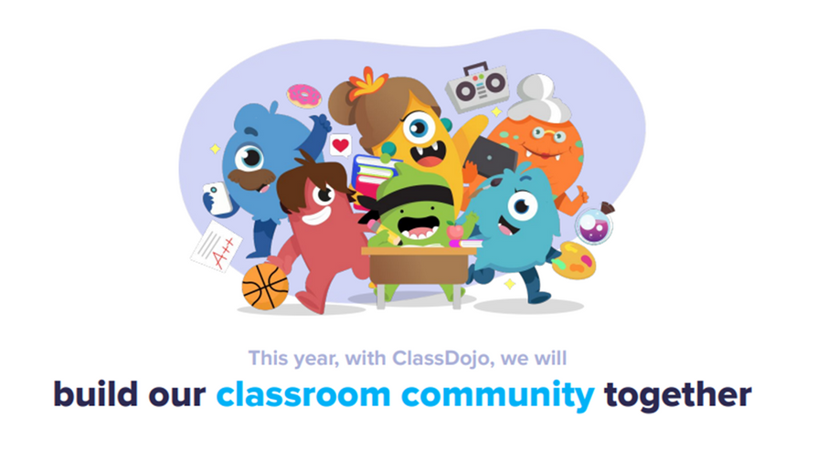
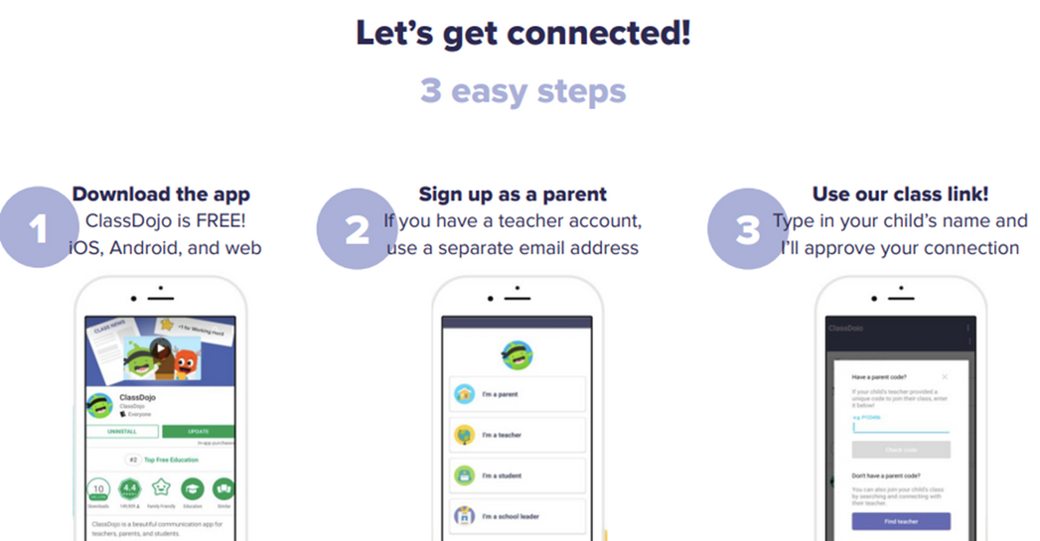
Class Dojo
We are excited to be fully using Class Dojo for the whole school. This is a school/home communication app that can be used to share work, information, and achievements! You will be able to see what we get up to in school and any team points your child has learnt.
We DO use this for:
Sharing your children’s learning and achievements with class dojos!
Whole class/school announcements of events or reminders
We DO NO use it for :
Concerns/complaints through private messaging – these STILL go through the school's central email.
Urgent, quick response messages – these still go through the school office
Any attendance queries or absences – these still go through the school office
PLEASE REFER TO THE CLASS DOJO CODE OF CONDUCT SO THIS GREAT APP CAN CONTINUE TO BE A GREAT SUCCESS!

Slide 10


We DO use this for:
  Sharing your children’s learning and achievements with class dojos!
  Whole class/school announcements of events or reminders
  Non urgent message/reminder to the class teacher which does not necessarily need a response
We DO NO use it for :
  Concerns/complaints through private messaging – these STILL go through the schools central email.
  Urgent, quick response messages – these still go through the school office
  Any attendance queries or absences – these still go through the school office
PLEASE REFER TO THE CLASS DOJO CODE OF CONDUCT SO THIS GREAT APP CAN CONTINUE TO BE A GREAT SUCCESS!

Slide 11
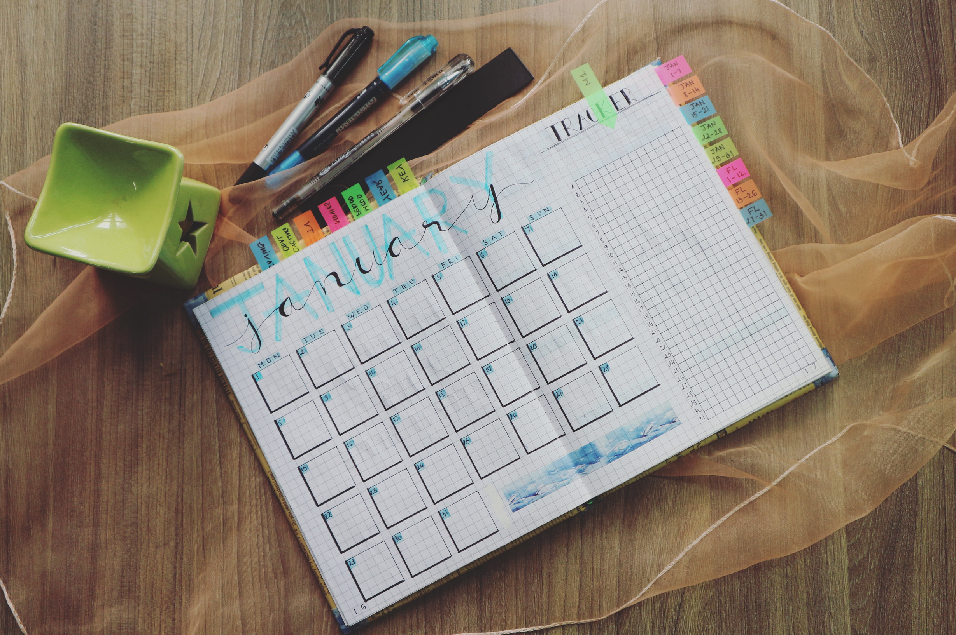
Homework
Children should read every night and complete AR quizzes in school regularly.
Year 4: TTRS should be done each night.
Year 3: Numbots should be done each night.
Any other homework will be posted to Class Dojo.
If you are ever unsure about any homework then please, LET ME KNOW!

Slide 12

Times Tables
Times Tables Rock Stars (TTRS) is an exciting times tables app that we will be using in school and at home. Children will be expected to use this app throughout the week. Each game takes 3-5 mins so it's perfect to fit into their routine e.g. in the car, before dinner, waiting for the bath to run etc.
https://www.youtube.com/watch?v=-ZxZbRVvbYM

Slide 13
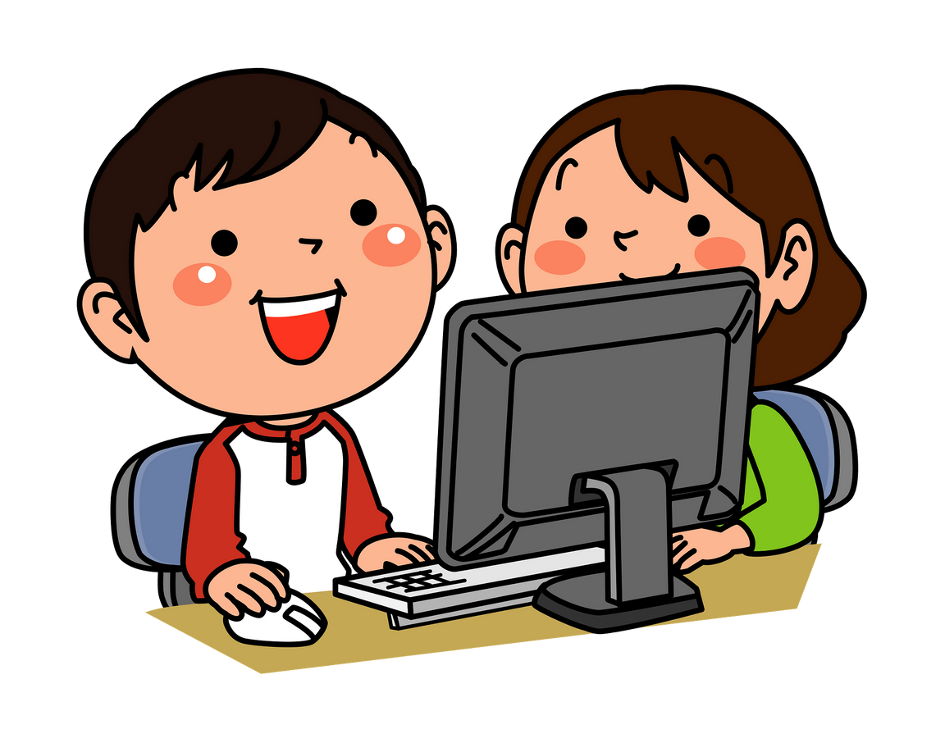
Year 4 National Times Tables Test
SUMMER TERM

Slide 14

What is the Multiplication Tables Check?
The Multiplication Tables Check (MTC) is a key stage 2
assessment to be taken by pupils at the end of year 4 (in
June). The purpose of the MTC is to make sure the times
tables knowledge is at the expected level. The
multiplication tables check (MTC) is statutory for primary
schools.
The MTC is an online test where the pupils are asked 25
questions on times tables 2 to 12. For every question you
have 6 seconds to answer and in between the questions
there is a 3-second rest. Questions about the 6, 7, 8, 9,
and 12 times table come up more often.

Slide 15
How can I help?
We would recommend a number of strategies to support your child in the run-up to and aftermath of the times tables test including:
•Times tables chanting: “6, 12, 18, 24…”
•Times tables chanting in reverse order: “108, 99, 90, 81…”
•Using times tables songs, like Schoolhouse Rock’s‘3 is A Magic
Number’
•Using apps, like the one byks2timestables.co.uk, Times Tables Rock
Stars or Hit the Button
•Using free online games, like those on Maths Frame
•Asking your child multiplication calculations out of order, like: “What is 4 x 7? What is 9 x 5? What is 6 x 11?”

Slide 16
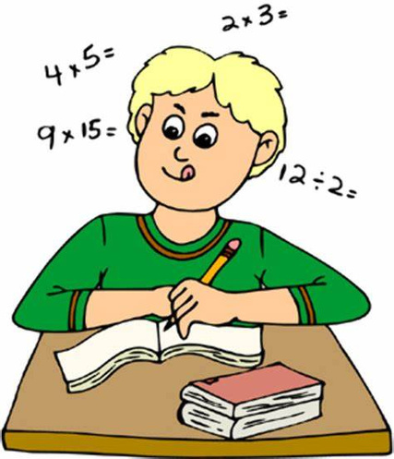
The following activity closely resembles the Multiplication Check that your child will take at the end of Year 4. Practicing this will greatly help your child become comfortable with the test format and improve their confidence.
https://mathsframe.co.uk/en/resources/resource/477/Mul
tiplication-Tables-Check

Slide 17


Accelerated Reader
  Super success over last few years.
  Engaged the children (almost everyone!)
  Each time they finish a book they quiz to test comprehension –target 85%
  Reward based.
  If every child in the class fully participates they will be at least at the expected level for their age group at the end of the year.
  Aim to complete one book a week if Orange/Green/Blue Band,
  Pink / Brown + one book a fortnight

Slide 18
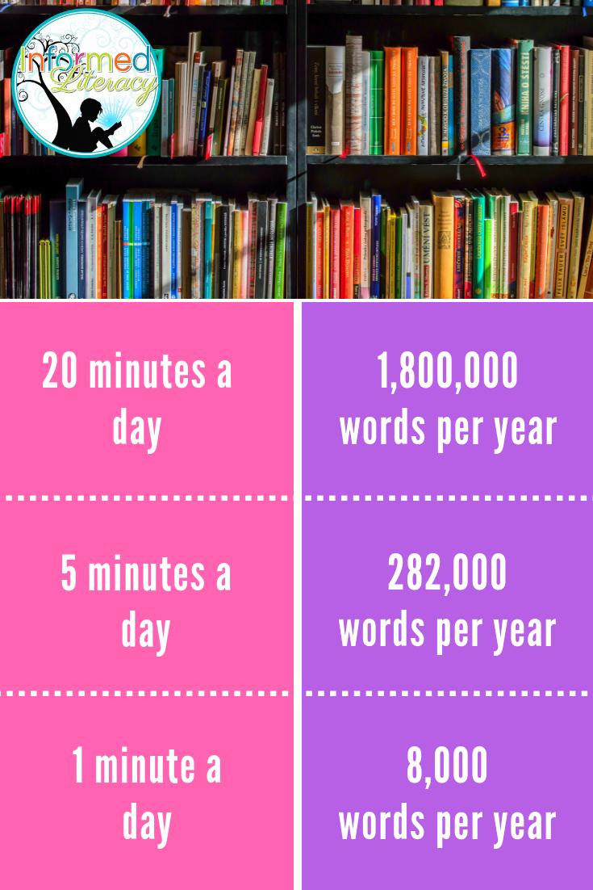
Children who read outside class daily are five times as likely to read above the expected level
for their age compared with children who never
read outside school.
National Literacy Trust's Children
and Young People's Reading, 2016

Slide 19
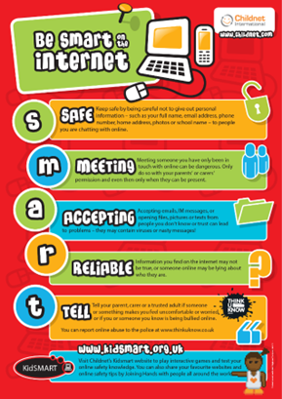
Online Safety (Safeguarding)
Safeguarding Lead (DSL) : Mrs Minshall-Thomas
Deputy Safeguarding Lead : Mrs Wagg,
Online Safety : Mrs Minshall-Thomas
Online Safety at Sound
  Built into the Curriculum Plans & special awareness days and weeks
  Continual Staff training
  School Safeguarding Team – pupil safeguarding leads work with the DSL, Safeguarding Governor, PC Jarvis & other external organisations
  Parental workshops and guides shared on our school platforms.
  regular updates/useful guides shared on Class Dojo
Online Safety - Sound and District Primary School (soundprimary.co.uk)

Slide 20
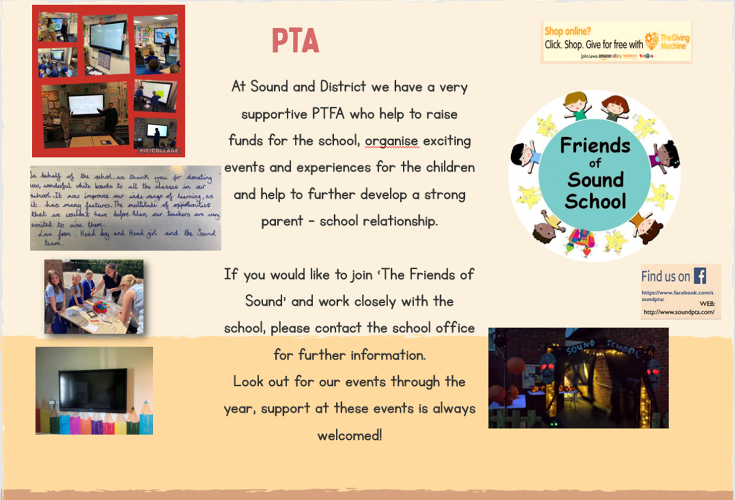
PTA
As well as the school office we now have the following contact: info@friendsofsoundschool.com

Slide 21

Any Questions?

Slide 22

Thank you!

