Slide 1



to Topaz Class
Tuesday 9th September 2025

Slide 2

Mrs Booth
Mrs Kyle
and…..
Mrs Huntbach (Art & DT)
Mrs Minshall-Thomas (Computing)
Mrs Kyle (RE, French & Music)

Slide 3





Our School Aims
Our Sound Superstars (our values)….
Be Resilient
Be Curious
Be Independent
Be Caring
Be a Team Player
Be Mental Health aware

Slide 4

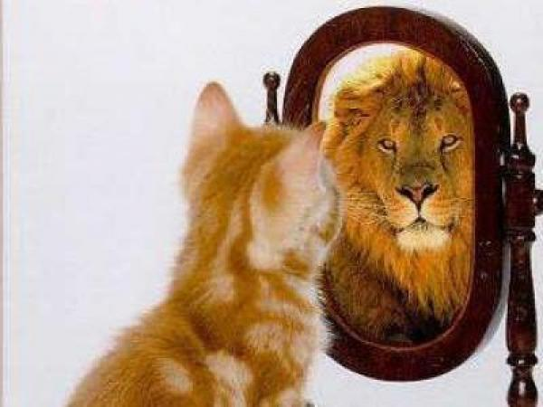


What we aim for…
Independence
Resilience
Respect
Good Communication
Enthusiastic Learners
Creative Thinking
Confidence
Responsibility
Risk taking
Team players
Decision Making

Slide 5


Role Models
Opportunities to lead others/take on different roles
Class/whole school roles
Classroom set up/Working Walls/Talk partners
Expectations
Wider opportunities
Inter-school working
Sound School Council

Slide 6


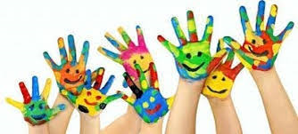
English-Talk For Writing
Maths
Science
Computing
SPAG
Geography & History-skills based
Art/Design & Technology
PE
French
Music
PSHE/British Values/Global Learning
RE

Slide 7

Accelerated Reader

Slide 8

Times Tables Rock Stars
https://www.youtube.com/watch?v=-ZxZbRVvbYM
Times Tables Rock Stars (TTRS) is an exciting times tables app that we will be using in school and at home. Children will be expected to use this app throughout the week. Each game takes 3-5 mins so it's perfect to fit into their routine e.g. in the car, before dinner, waiting for the bath to run etc.

Slide 9
What can you do to help your child practise their times tables?
We would recommend a number of strategies to support your child in the run-up to and aftermath of the times tables test including:
Times tables chanting: “6, 12, 18, 24…”;
Times tables chanting in reverse order: “108, 99, 90, 81…”;
Using times tables songs, like Schoolhouse Rock’s ‘3 is A Magic Number’;
Using apps, like the one by ks2timestables.co.uk, Times Tables Rock Stars or Hit the Button
Using free online games, like those on Maths Frame;
Asking your child multiplication calculations out of order, like: “What is 4 x 7? What is 9 x 5? What is 6 x 11?”;

Slide 10
Year 4 National Times Tables Test Summer Term

Slide 11

What is the Multiplication Tables Check?
The Multiplication Tables Check (MTC) is a key stage 2 assessment to be taken by pupils at the end of Year 4 (in June). The purpose of the MTC is to make sure the times tables knowledge is at the expected level. The multiplication tables check (MTC) is statutory for primary schools.
The MTC is an online test where the pupils are asked 25 questions on times tables 2 to 12. For every question you have 6 seconds to answer and in between the questions there is a 3-second rest. Questions about the 6, 7, 8, 9, and 12 times table come up more often.

Slide 12

Writing

Slide 13
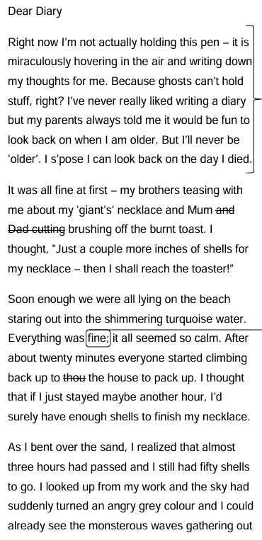
Sentence construction . A
Handwriting
Make sense?
Word choices
Imagination

Slide 14
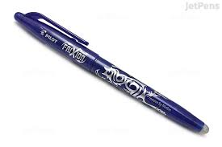

Slide 15


Slide 16


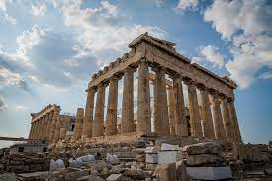

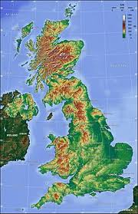
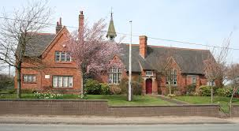
History & Geography…
UK Geography
Monarchs
Our Changing World
Tudors
Field Work
Local History

Slide 17


Wednesdays & Fridays

Slide 18

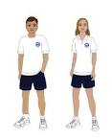
Black shorts/leggings/
joggers
Blue/white T-shirt
School Hoody
Woolly hats are useful in the winter months!
Trainers (both indoor & outdoor in winter)
Come in in kits for the day
Please put your child’s name in every item!

Slide 19
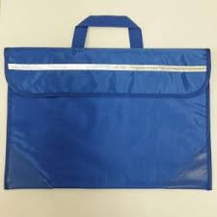

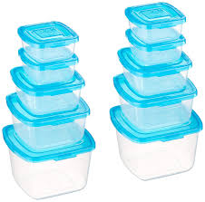
Bags
Pencil Cases
Lunchboxes
Drink bottles
Recycling

Slide 20



Slide 21


Spellings-under review- spelling rules/using phonics
Homework- where applicable
It is vital for your child to read at least 5 times per week. Please record in their diary and parent/adult to initial.

Slide 22
Help from home…
Reading of different genres & questioning for understanding
Mental Arithmetic – multiplication table, square numbers, prime numbers, square roots, times tables
Spelling rules
Handwriting
Extra work after lessons – DRIP! DRIP!
Useful websites: BBC Skillwise, Coxhoe Durham, TOPMARKS, Nrich
Checking homework-not doing it!
COHESION!

Slide 23
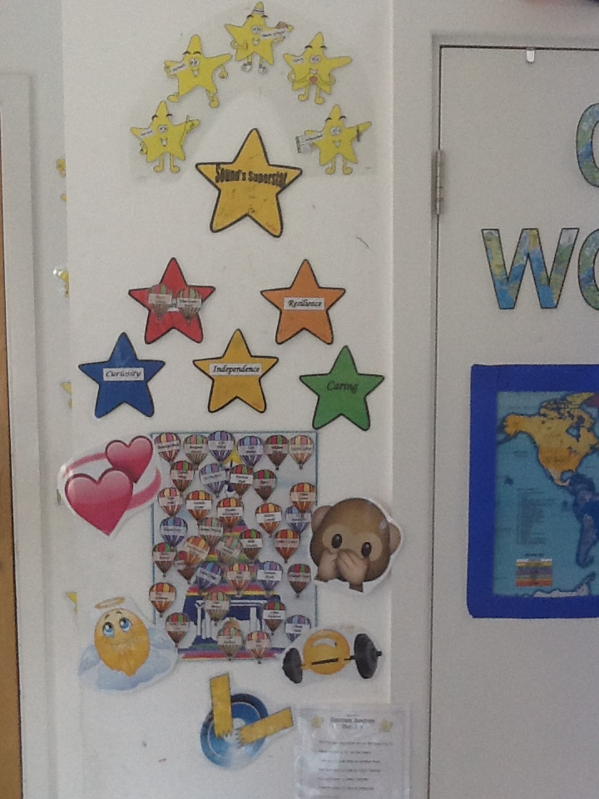

Behaviour…
Sound Super Star Awards
Sound Bell Tower
? Warning: make a choice & THINK
! Miss breaktime/appropriate action
Deputy Head or Headteacher-
phone call home/parent meeting

Slide 24
Home - School Communication
It is really important that as a school we keep strong communications between home and school. You can use the methods below to share information with staff at Sound.
Use the children’s diaries/planners to record reading through the week.
If you wish to speak directly to a member of staff (and it is something you would rather not share in the planner or SHOULD NOT BE SHARED ON CLASS DOJO) either ring the school office (01270780270) to arrange a meeting or email admin@sound.cheshire.sch.uk . They will then get back to you as soon as possible. Please add for the attention of (add teacher/staff member it is for)
All communications should first and foremost go through to the class teacher, unless it is something which is needed to be directed to the Deputy or Headteacher.
We will keep you regularly updated through our website, Facebook, and Class Dojo. You will also receive Mrs Minshall-Thomas’s weekly highlights, giving you a snapshot of what’s going on in school..
Reminders, or other general information will go through our teachers2parentsapp and Class Dojo. We will be keeping both running for now through school. Microsoft Teams will be used for Virtual Parent Meetings.
https://soundprimary.co.uk

Slide 25
Sound School Communications
Please see below the communications that will be used by Sound School and what for.
Teacher2Parents (Eduspot) | Class Dojo | School Website | School Facebook | Face to Face
Admin/Staff emails | Children's Dojos for Positive Behaviour | Whole School key documents | Weekly highlights of school events & achievements for our wider community | Staff/Headteacher on the playground at the beginning and end of day – quick memos.
Electronic letters | Share pupils work and achievements | School Policies/Procedures |  | In person Parent Meetings
Confidential Documents | Sharing pictures of the curriculum in action! | Galleries of achievements/ events over the whole year |  | Open Days
School Dinners | Class/whole school announcement/ reminders of events etc.. | Attendance Information
Parent Bookings |  | School Curriculum overviews
Confidential emails
All attendance queries

Slide 26
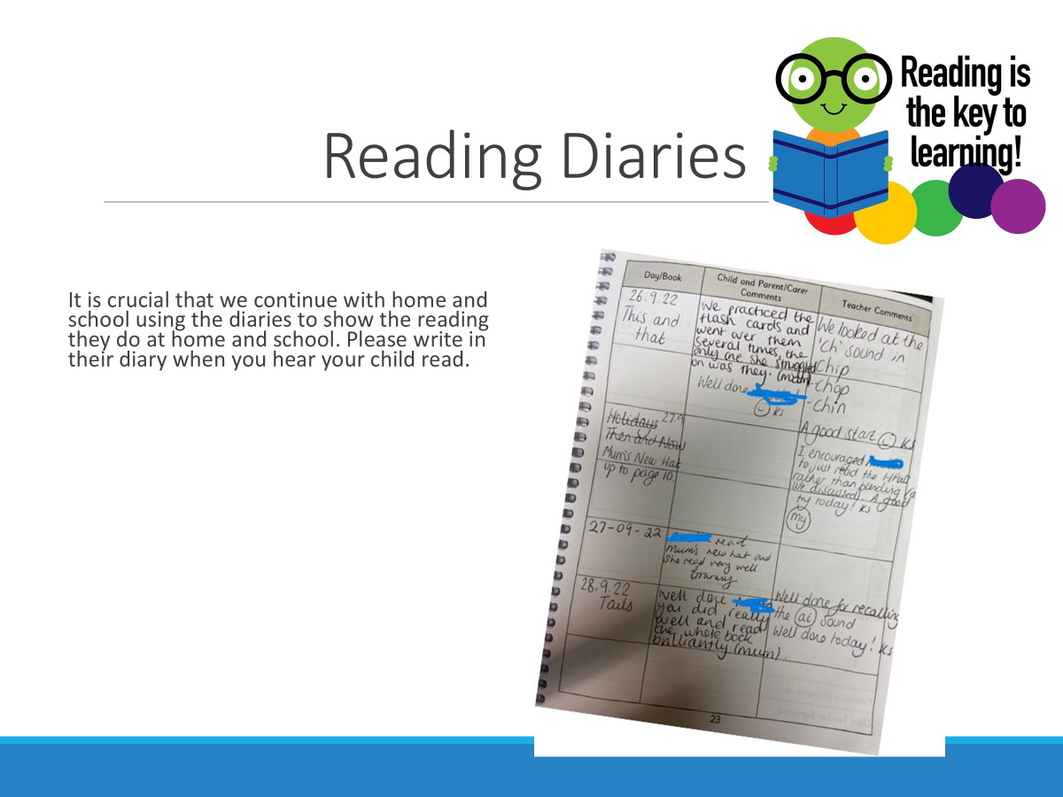

Slide 27
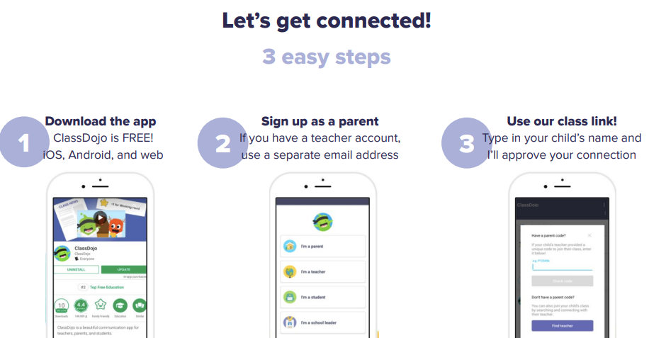
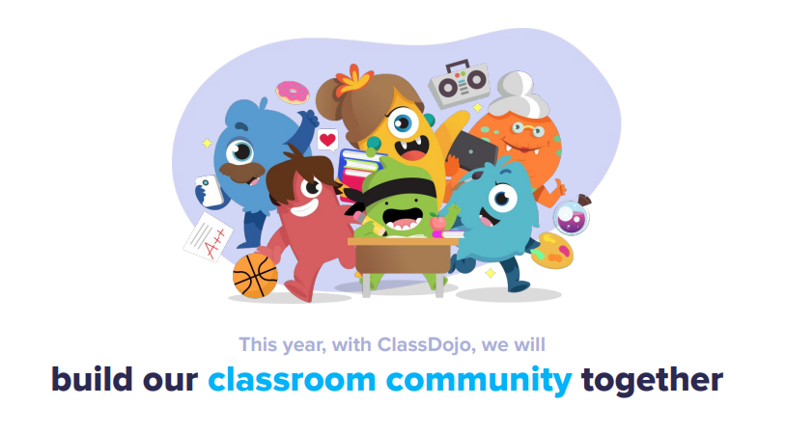
Class Dojo
We are excited to be fully using Class Dojo for the whole school. This is a school/home communication app that can be used to share work, information, and achievements! You will be able to see what we get up to in school and any team points your child has learnt. I will go into more detail at the end of the meeting.
We DO use this for:
Sharing your children’s learning and achievements with class dojos!
Whole class/school announcements of events or reminders
We DO NO use it for :
Concerns/complaints through private messaging – these STILL go through the school's central email.
Urgent, quick response messages – these still go through the school office
Any attendance queries or absences – these still go through the school office
PLEASE REFER TO THE CLASS DOJO CODE OF CONDUCT SO THIS GREAT APP CAN CONTINUE TO BE A GREAT SUCCESS!

Slide 28
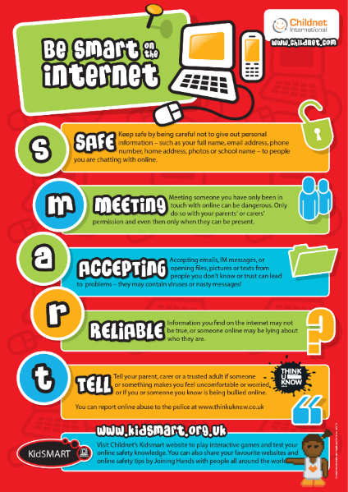
Online Safety (Safeguarding)
Safeguarding Lead (DSL) : Mrs Minshall-Thomas Deputy Safeguarding Lead : Mrs Wagg,
Online Safety : Laura Minshall-Thomas
Online Safety at Sound
- Built into the Curriculum Plans & special awareness days and weeks
- Continual Staff CPD
- School Safeguarding Team – pupil safeguarding leads work with the DSL, Safeguarding Governor, PC Jarvis & other external organisations
- Parental workshops and guides shared on our school platforms.
- regular updates/useful guides shared on Class Dojo
Online Safety - Sound and District Primary School (soundprimary.co.uk)

Slide 29
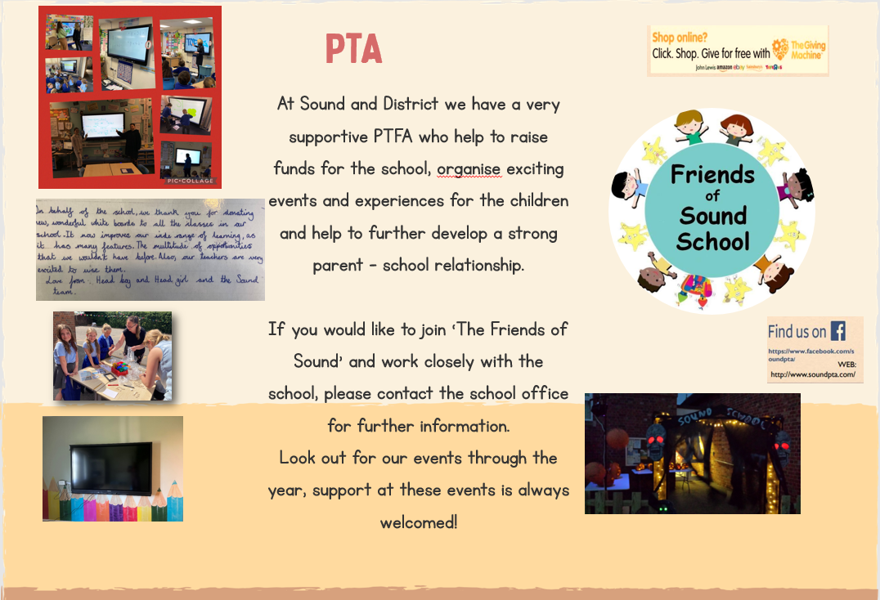
As well as the school office we now have the following contact : info@friendsofsoundschool.com

Slide 30

Questions…

