Slide 1

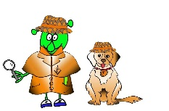

French Y4 Stage 2 Autumn 1: Classroom objects and asking for an item .
Language Detectives’ Memory Bank: Classroom objects and asking for an item.
Noun Bank
La salle de classe- the classroom
Le sac à dos – the rucksack
Le crayon- the pencil
Le stylo- the pen
Le livre- the book
Le taille de crayon-pencil sharpener
La gomme- the eraser
La table- the table
La chaise- the chair
La règle- the ruler
Des ciseaux- some scissors
Des crayons de couleurs- some coloured pencils
De la colle – some glue
Sound Bank
Classroom nouns
Question and answer- have you/ I have (have not …)
Sound spelling
“sty”
“aille”
“eau”
“as”
Grammar Bank
To say “I have” in French we use “j’ai” (I have).
To say the negative ( I have not..) we use “je n’ai pas…
Question and Answer Bank
As-tu …….? – Have you got ……?
J’ai …… - I have ……
Je n’ai pas …- I have not ……

Slide 2
French Y4 Stage 2 Autumn 2:Town and shops.
Language Detectives’ Memory Bank of “Town and Shops”
Noun Bank
Le café- the cafe
Le cinéma- the cinema
Le restaurant – the restaurant
Le supermarché- the supermarket
Le stade – the stadium
La boucherie- the butchers
La boulangerie- the bakers
La patisserie- the cake shop
La pharmacie- the chemist
L’école – the school
Sound Bank
Shops nouns
Question and answer
Grammar
When a noun begins with a vowel and it is being used with “le” or “la”, then the vowel at the end of “le” or “la” is replaced with an apostrophe
e.g. l’ école
Sound spelling
“ie”
“ou”
“oi”
“est”
Facts
In English we have borrowed some French nouns for places in town e.g. café , cinema, restaurant..
Question and Answer Bank
Où est….?- Where is ….?
Voici - Here is ……

Slide 3
French Y4 Stage 2 Spring 1: Parts of face
Language Detectives’ Memory Bank of “parts of the face”.
Noun Bank
Le nez – the nose
La bouche- the mouth
La tête- the head
Les cheveux- the hair
Les yeux – the eyes
Les oreilles- the ears
Grammar
There are two words for “the” in French with singular nouns (le and la)
There is only one word for “the” with French plural nouns and this is “les”.
Sound spelling
sont
ez
che
eux
Sound Bank
Parts of the face nouns
Question and answers
Question and Answer Bank
De quelle couleur est ….? – What colour is …?
De quelle couleur sont….? What colour are….?
La bouche est …. - The mouth is……
Les oreilles sont ….. The ears are…..
Fact Bank
In English hair is a singular noun and in French “hair” is a plural noun (les cheveux).

Slide 4
French Y4 Stage 2 Spring 2: parts of the body
Language Detectives’ Memory Bank of “parts of the body”
Command Bank (verbs)
Bougez - move
Regardez- look
Ecoutez- listen
Dansez - dance
Chantez- sing
Touchez- touch
Grammar
The plural word for “the” in French is “les”.
“S” and “X” are silent letters that are often added to end of the noun to make the plural ending of the noun e.g. le pied /les pieds
Nouns Bank
Le pied – the foot
Les pieds- the feet
La jambe- the leg
Les jambes- the legs
Le bras – the arm
Les bras- the arms
La main – the hand
Les mains – the hands
La tête – the head
Le genou- the knee
Les genoux- the knees
Sound Bank
Body part nouns
Movement commands
Grammar
We say and write colours as adjectives after the noun in French.
Grammar
When we say and write colours as adjectives after the noun in French the spelling may change to match the noun.
Sound spelling
“bou”
“as”
“en”
Fact Bank
In French the “s” and the “x” on the end of a word are silent letters.

Slide 5
French Y4 Stage 1 Summer 1 I don’t feel well
Language Detectives’ Memory Bank of “I don’t feel well”
“I don’t feel well” -Questions and Answers bank
Qu’est-ce qu’il y a ?- What’s wrong?
Je ne me sens pas bien- I don’t feel well
J’ai mal aux dents- My tooth
J’ai mal à la tête- I have a headache
J’ai mal à l’oreille- I have earache
J’ai mal au ventre - I have tummy ache
Je me suis coupé au genou- I have cut my knee
Sound spelling
“ven”
“sens”
“dents”
“eille”
Sound Bank
“I don’t feel well” questions and answers

Slide 6
French Y4 Stage 2 Summer 2 – weather.
Language Detectives’ Memory Bank of weather.
Weather question and answers bank
Quel temps fait-il?- what’s the weather like?
Il fait du soleil – It’s sunny
Il fait du vent – It’s windy
Il fait du brouillard- It’s foggy
Il fait chaud – It’s hot
Il fait froid – it’s cold
Il neige – It’s snowy
Il pleut – It’s raining
Sound spelling
“emps”
”fait”
“ouill”
“aud”
Sound Bank
Weather question
Weather answers
Fascinating facts
Most consonants at the end of the word in French are silent letters.
Listen to the sound files and read along with the words and spot the silent letters.

Slide 7
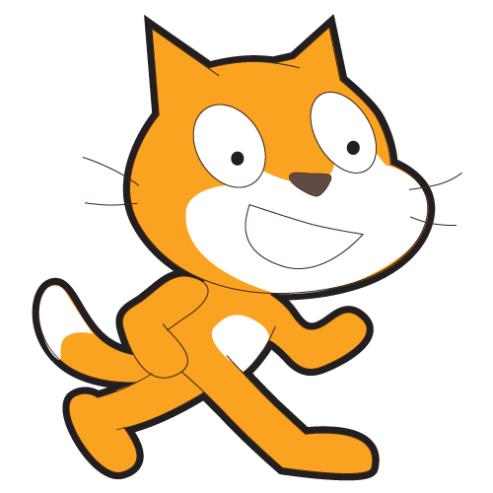
Scratch Beginners
Lesson 5

